Slide 1
Should the Government Ban Single-use Plastics?
Jiang Guanlin (David)
Lam Ka Hang (Andy)

Slide 2
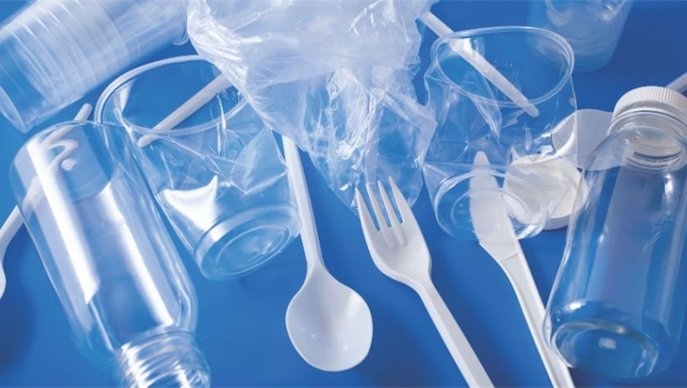
Plastics ---a valuable and dangerous product in this world.

Slide 3
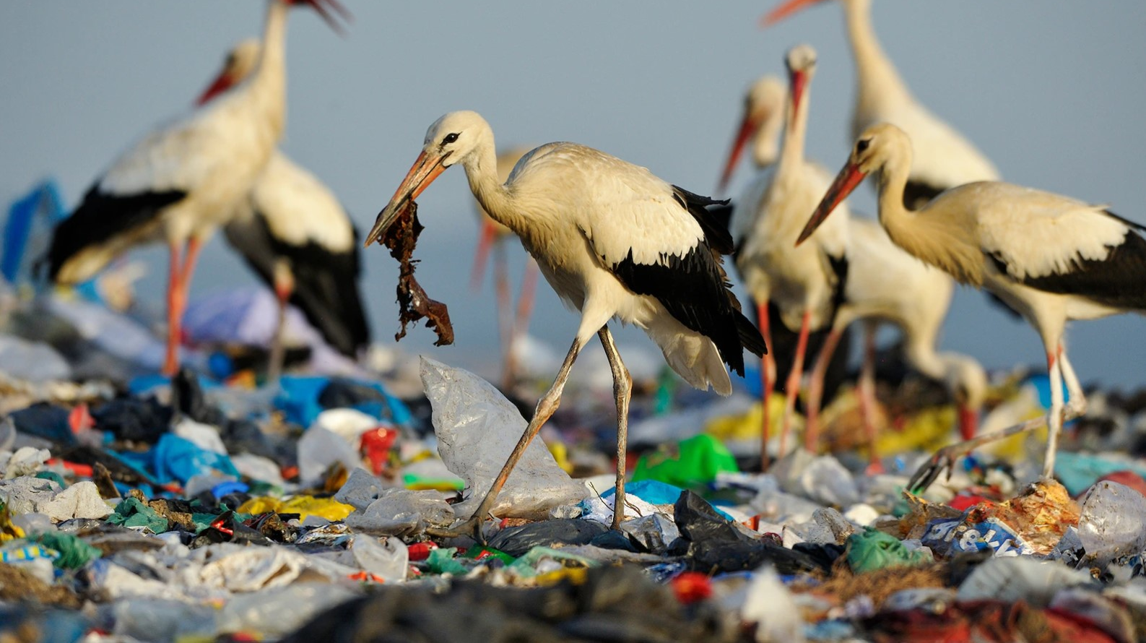
Nowadays, plastics show more terrible influences on this beautiful earth, a lot of animals because of plastics pollution dead in this “wonderful” world

Slide 4
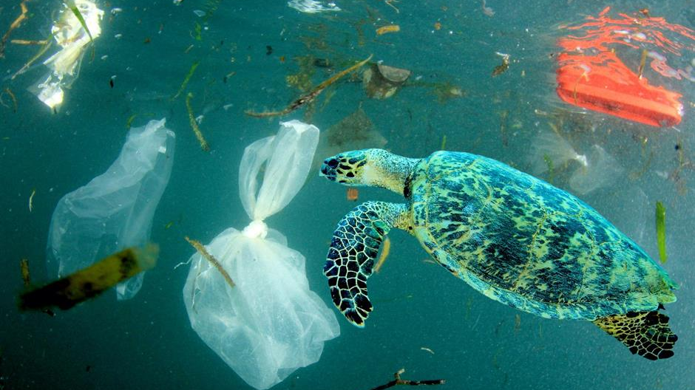
Ocean because of that no longer blue and fascinating to attract people visit.

Slide 5
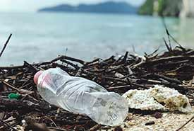
In the UK, currently, every year, the average English person uses 18 throwaway plastic plates and 37 one-time cutleries.

Slide 6

Since 2015, the UK government has reduced the use of single-use plastics by increasing the price of plastic bags to 5 pence. For example, the sales of plastic bags in cities have been reduced by 95%. The government also has a refund plan if people back the plastic bottle to them.

Slide 7
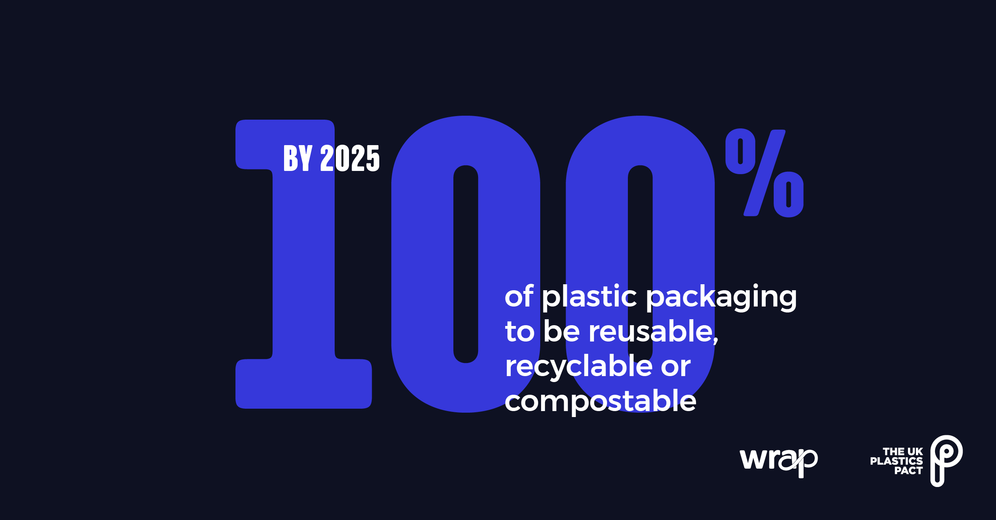
In the next few years, The UK government will increase control over plastics policy, and they plan to increase the price to 10 pence, which may further reduce the usage rate. They will start to charge the plastic tax to some companies if the plastic production company does not reduce emissions.

Slide 8
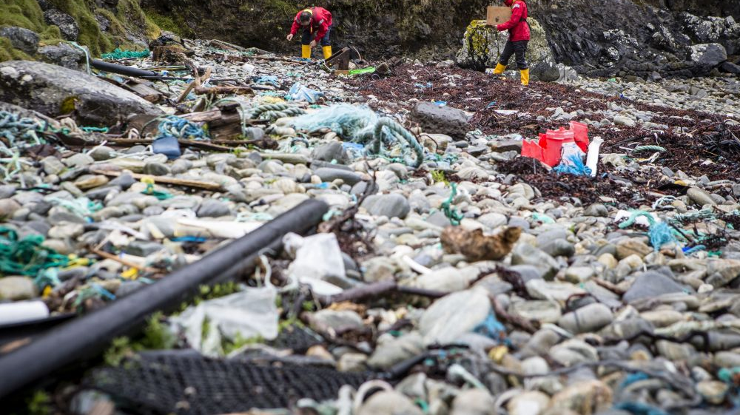
In the US, 37 million tons of plastics are used every year, which packaging, and food services plastics represent about 16 million tons that topically are single-use plastics.

Slide 9
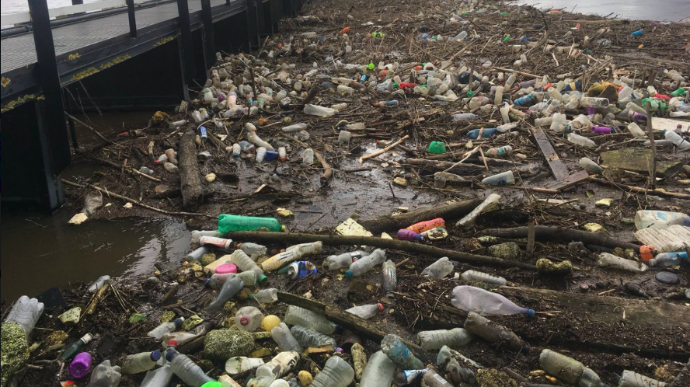
With this in mind, many states in the US have set fees for the usage of plastics and even banned the use of single-use plastics bags. In the foreseeable future, the government is planning to undertake forceful actions to effectively recycle 50% of plastic packaging by 2025.

Slide 10
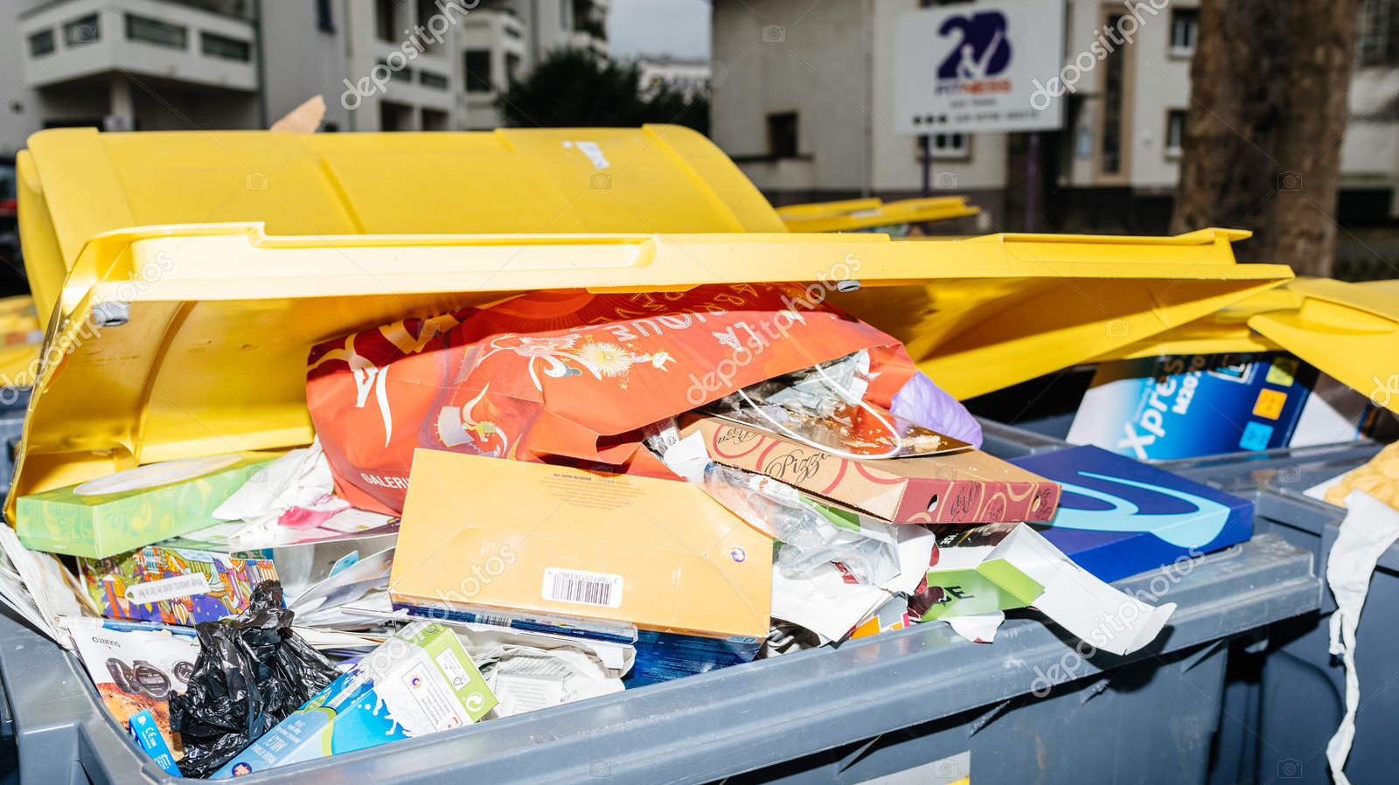
In France, it measures that 37% of fresh fruits and vegetables are packaged in plastic and it is believed that 100 billion disposable plastic goods are sold and produced by the fast-food sector.

Slide 11
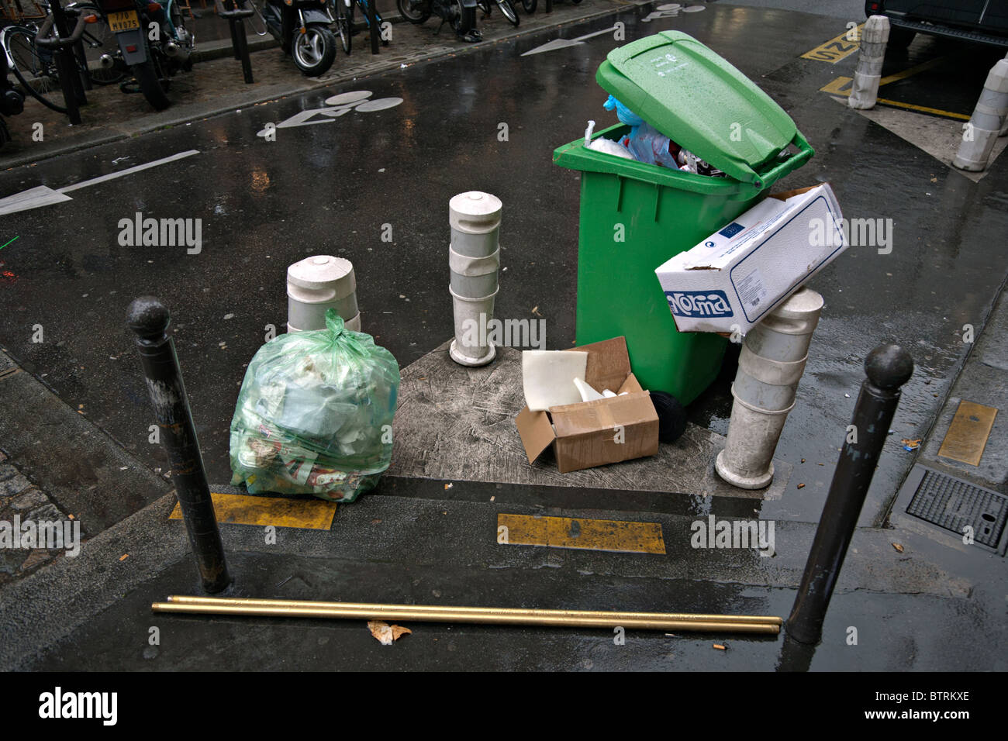
In a bid to encourage re-use, France’s anti-waste law press consumers to bring re-usable containers into retail stores to purchase items, as long as the container is clean and suitable for the products purchased

Slide 12
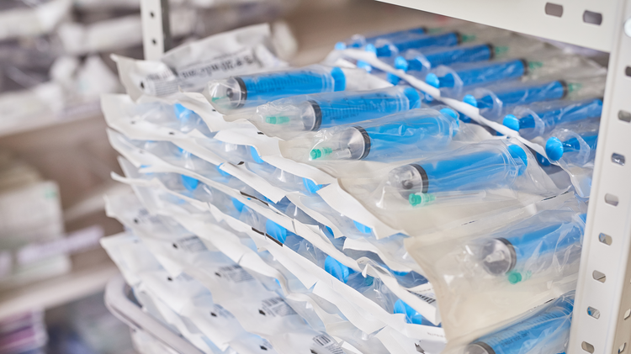
But they also have some benefits for people. Like some nurses and doctors in Hospital, they use single-use plastics to protect the medical equipment does not pollute

Slide 13
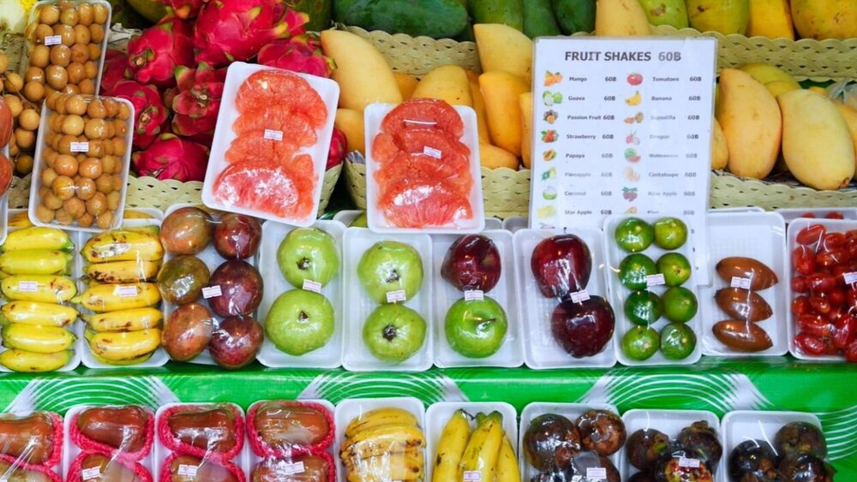
help cook to preserve food and make it pollution-free

Slide 14
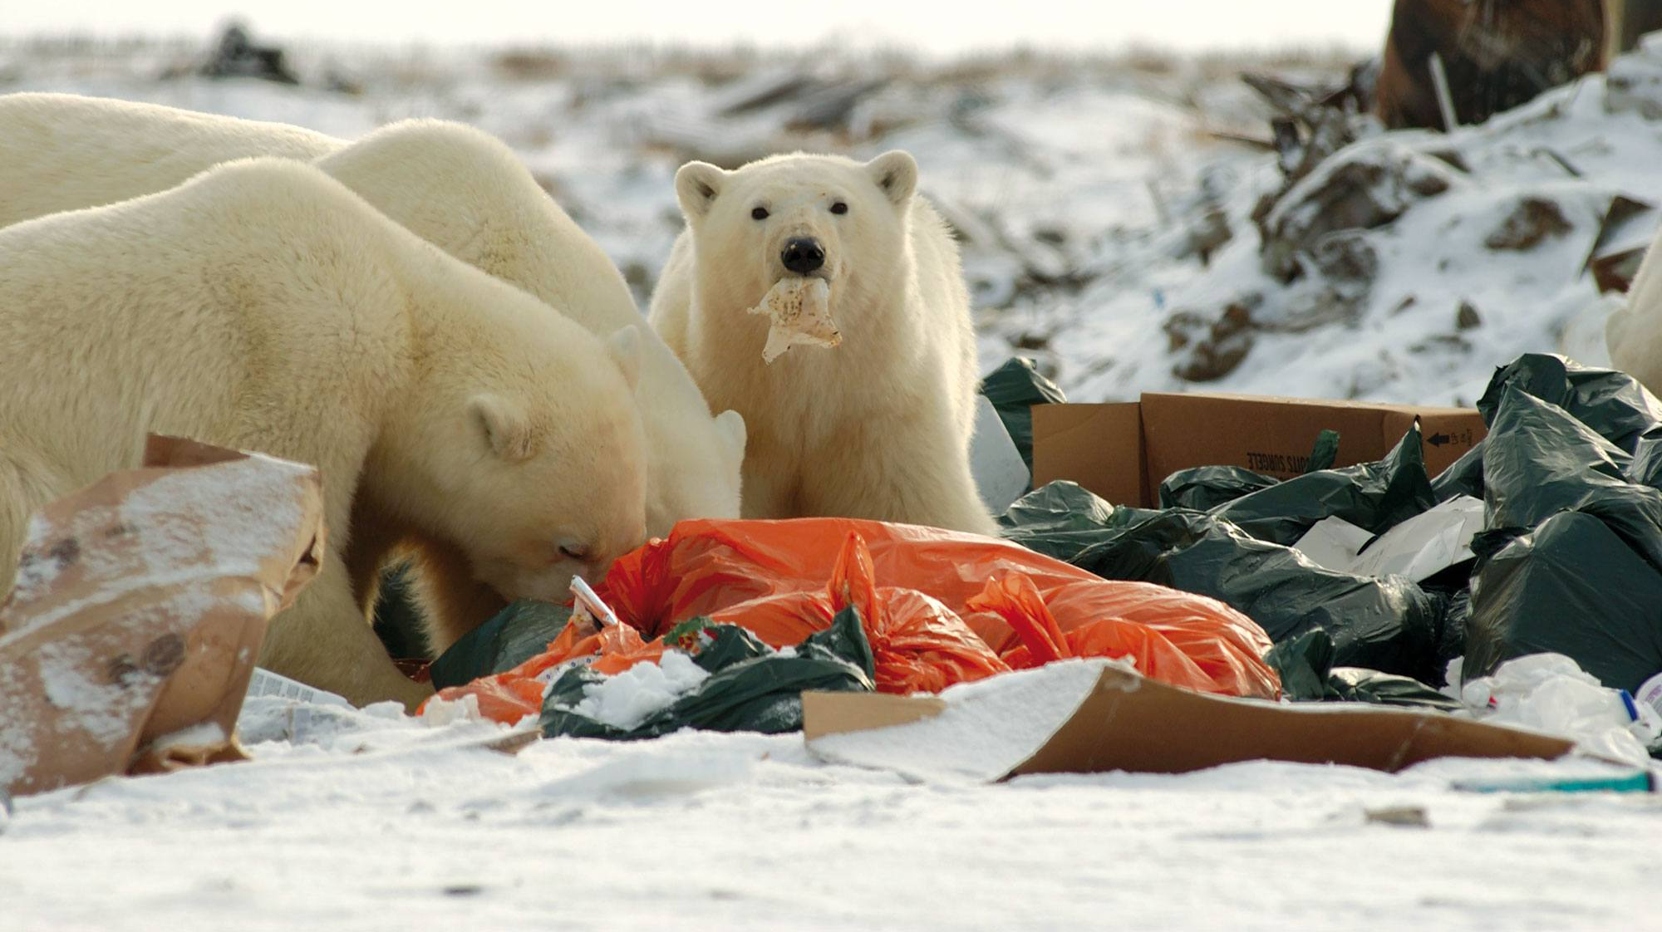
There are still a lot of disadvantages to use single-use plastics. Plastic may cause direct harm to the animals, lead to the Pacific trash vortex, and production of greenhouse gases.

Slide 15
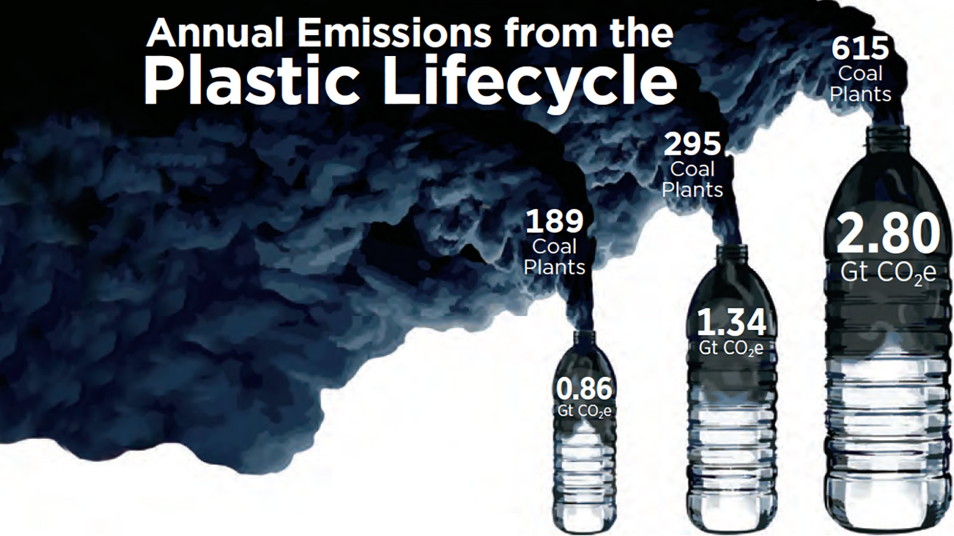

Slide 16
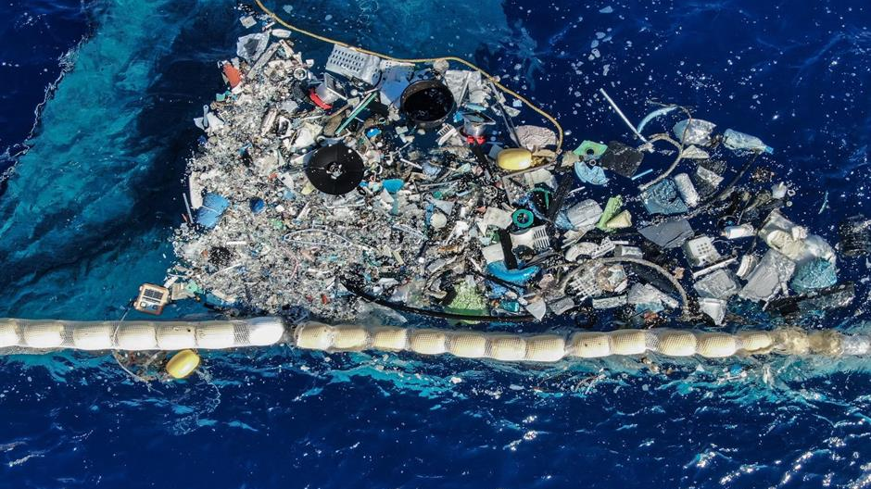
US, UK, France these 3 countries both are having or will be having some policies to against single-use plastics. US and UK already have some behaviors to show the confidence they need to reduce it.

Slide 17
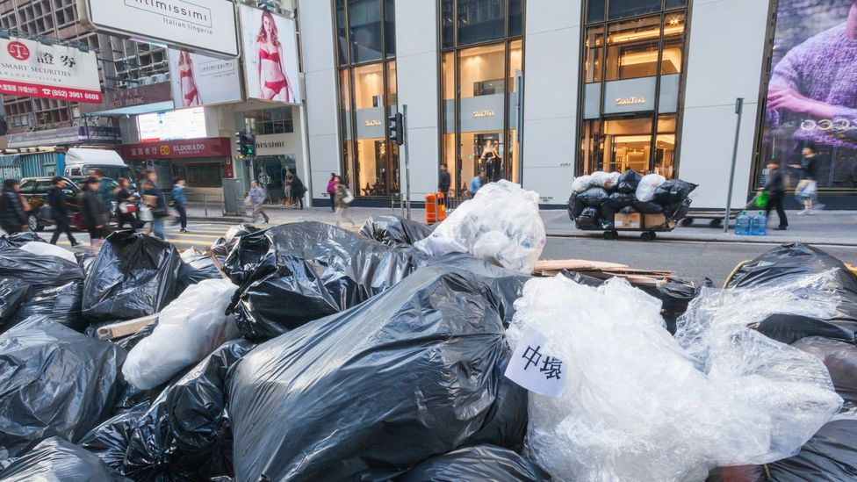
to let more people, know that using more plastics are not beneficial for people,

Slide 18
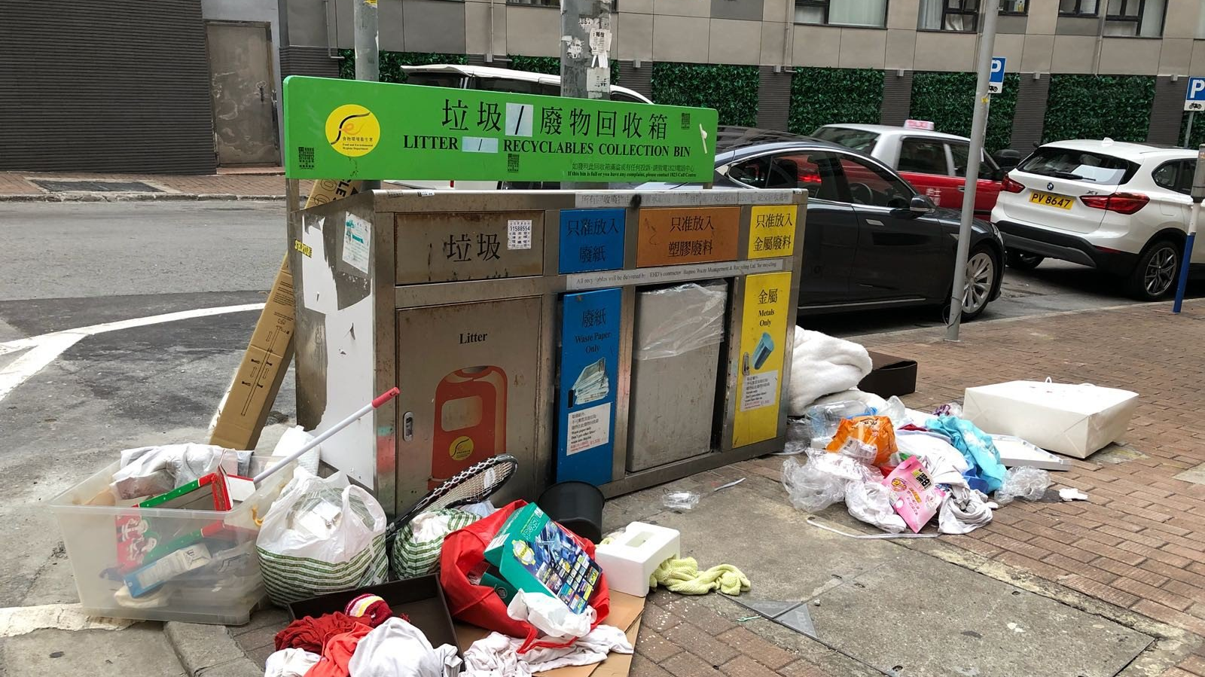
like posters, and reduce the plastics from stores, if give too much, they need to provide some tax.

Slide 19
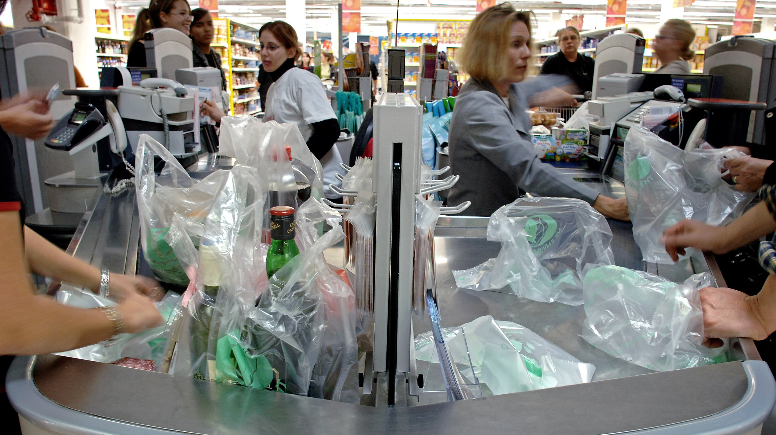
The policy that France government published is that in the future few years, from 2022, the roads in France must deploy the water fountains to reduce the buying and selling of bottled water. Also, France will ban the use of disposable plastic tableware during meals.

Slide 20
Websites References
Clercq, G. V. D. (2021, October 12). New law in France will save 1 billion pieces of single-use plastic annually. World Economic Forum. https://www.weforu m.org/agenda/2021/10/how-france-plans-to-significantly-reduce-its-plastic-waste-from-2022/
Connexion journalist. (2020, December 31). France tightens plastics ban. The Connexion French news and views. https://www.connexionfrance.com/Practical/Environment/France-tightens-plastics-ban
Department for Environment, Food & Rural Affairs. (2021, August 28). Next steps to tackle plastic waste. https://www.gov.uk/government/news/next-steps-to-tackle-plastic-waste
Giddings, D. (2021, March 29). The effects of single-use plastic on the environment. Nature Conservancy Canada. https://www.natureconservancy.ca/en/blog/t he-effects-of-single-use-plastic.html
Ho, S. (2021, September 6). UK to ban single-use cutlery and tableware in 'war on plastic'. UK To Ban Single-Use Cutlery and Tableware In ‘War On Plastic.’ https://www.greenqueen.com.hk/uk-single-use-plastic-ban/
Hundertmark, T., Prieto, M., Ryba, A., Simons, T. J., & Wallach, J. (2019, December 20). Accelerating plastic recovery in the United States. https://www.mckin sey.com/industries/chemicals/our-insights/accelerating-plastic-recovery-in-the-united-states
National Conference of State Legislatures. (2021, August 2). State Plastic Bag Legislation. https://www.ncsl.org/research/environment-and-natural-resources/plastic-bag-legislation.aspx
Packaging Europe. (2021, October 12). Plastic packaging for fruit and vegetables to be banned in France. Packaging Europe. https://packagingeurope.com/plastic-packaging-fruit-and-vegetables-banned-in-france/
Plastic Packaging Facts. (n.d.). Benefits of single-use plastics in Healthcare & Food Safety. Plastic Packaging Facts. https://www.plasticpackagingfacts.org/resources/sanitation-and-safety-plastics-benefits/
U.S. Plastics Pact. (2021, June 15). U.S. Plastics Pact unveils national strategy to achieve 2025 circular economy goals. U.S. Plastics Pact. https://usplastics pact.org/u-s-plastics-pact-unveils-national-strategy-to-achieve-2025-circular-economy-goals/

Slide 21
Image References
Abaca Press. (n.d.). Collecting plastic, the Pacific Ocean. [Photograph]. Love Exploring. https://www.loveexploring.com/gallerylist/94665/these-images-show-the-true-impact-of-plastics-on-our-oceans
Alamy. (2010). rubbish in paris France. [Photograph]. Alamy. https://www.alamy.com/stock-photo-rubbish-in-paris-france-32482646.html
Carey, R. (n.d.). The shocking truth about plastic. [Photograph]. Love Exploring. https://www.loveexploring.com/gallerylist/94665/these-images-show-the-true-impact-of-plastics-on-our-oceans
CIEL. (2019). Annual Plastic Emissions. [Photograph]. CIEL. https://grist.org/article/the-plastic-industry-is-on-track-to-produce-as-many-emissions-as-600-coal-fired-power-plants/
Climate Action. (2018). [Photograph]. https://www.climateaction.org/news/uk-parliament-to-eliminate-their-single-use-plastic-by-2019-with-compostabl
Doest, J. (2019). White storks forage at a landfill in Spain. [Photograph]. National Geographic. https://www.nationalgeographic.com/animals/article/whales-eating-plastic-pollution
Global Citizen. (n.d.). Courtesy of Blue Planet Society. [Photograph]. https://www.globalcitizen.org/en/content/yorkshire-flooding-shocking-plastic-pollution/
Ifeelstock. (2019). French street in Paris with gray yellow dumpsters full of paper cardboard boxes after new year holidays. [Photograph]. Depositphotos. https://depositphotos.com/241104902/stock-photo-french-street-in-paris-with.html
Ksiazek, J. (n.d.). Billion of fine plastic bags distributed in shops pose, if not reused, a real ecological problem. [Photograph]. AFP. https://www.planete-energies.com/en/medias/close/france-s-single-use-plastic-bag-regulation
Plastic Soup Foundation. (n.d.). HARM TO ANIMALS. [Photograph]. Plastic Soup Foundation. https://www.plasticsoupfoundation.org/en/plastic-problem/plastic-affect-animals/
Reuters Events. (n.d.). One of the goals of the UK Plastics Pact. [Photograph]. Reuters Events. https://www.reutersevents.com/sustainability/analysis-uk-retailers-plastics-pact-must-be-backed-real-change
SCMP. (n.d.). This recycling bin in Happy Valley hasn't been emptied or cleared in over four days – and it’s a pretty regular sight in Hong Kong. [Photograph]. SCMP. https://www.scmp.com/yp/discover/news/environment/article/3069763/we-tried-live-plastic-free-week-hong-kong-and-what
Sheila, C (n.d.). Discarded pastic bottle by the beach. [Photograph]. Pexels. https://www.natureconservancy.ca/en/blog/the-effects-of-single-use-plastic.html
UK GOV. (n.d.). [Photograph]. UK GOV. https://www.gov.uk/government/news/commonwealth-unites-to-end-scourge-of-plastic

Slide 22
Software References
Adobe. (2021). Adobe Premiere Pro. [Computer Software]. https://www.adobe.com/hk_en/products/premiere.html
Microsoft. (2021). Windows Video Editor. [Computer Software] https://education.microsoft.com/en-us/resource/1febf818
Zoom Video Communications. (2021). Zoom Meetings Client. [Computer Software]. https://explore.zoom.us/en/products/meetings/

